Slide 1
Intel 80286 Microprocessor

Slide 2
80286
16-bit processor
1st family member designed specifically for use as the CPU in a multiuser computer.

Slide 3
Multiuser-multitasking O.S. concept
The CPU runs the user programs on a timesharing basis. An O.S. which co-ordinates this is referred to as Multi-user O.S.
The program or a section of a program for each user is referred to as a task or a process, so a multi-user O.S. is also called as a Multi-Tasking O.S.

Slide 4
Intel 80286(16-bit microprocessor)
16-bit ALU
Maximum segment size 64k
Uses a math coprocessor 80287
Can operate in any of the 2 memory modes,viz:
– Real Address mode
– Protected virtual address mode

Slide 5
Real Address mode
Physical address=Segment Base + Offset Address
Maximum physical address 1Mb.
Uses CS, ES, DS, SS as base registers

Slide 6
Protected Virtual Address Mode
The address unit functions as a complete MMU(Memory management Unit).
It uses all 24 address lines to access upto16Mbytes of Physical memory
Provides up to 1Gb. of virtual memory using the descriptor table scheme

Slide 7
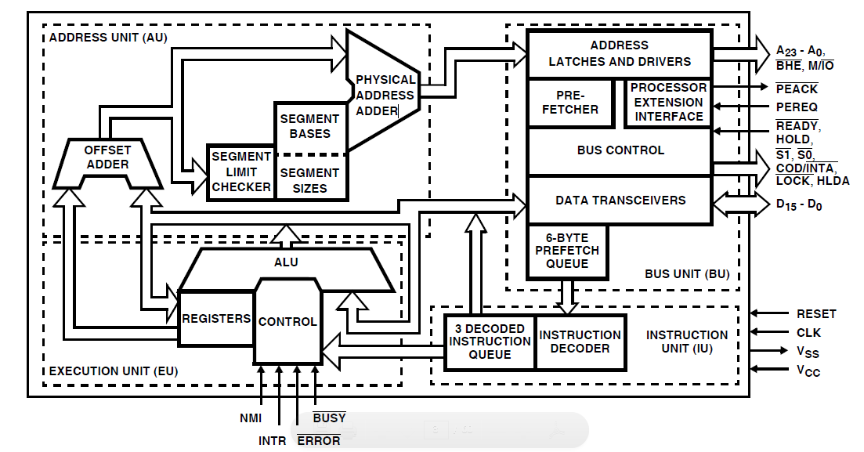
Architecture of 80286

